Slide 1
Tips to do great pOwerpoint presentations

Slide 2
Use a cool template
(This one is ugly and boring)

Slide 3
Choose good fonts!
Hello I am comic sans and nobody likes me

Slide 4
This is the old Times New Roman

Slide 5
Less is more!
Text, text, text, text, text, text , text, text, text, text, text, text
Text, text, text, text, text, text , text, text, text, text, text, text
Text, text, text, text, text, text , text, text, text, text, text, text
Text, text, text, text, text, text , text, text, text, text, text, text
Text, text, text, text, text, text , text, text, text, text, text, text
Text, text, text, text, text, text , text, text, text, text, text, text
Text, text, text, text, text, text , text, text, text, text, text, text
Text, text, text, text, text, text , text, text, text, text, text, text
There’s so much text that you won’t even read this

Slide 6
Don’t add too much text!

Slide 7
And let the audience listen to you

Slide 8
The slide is not a manuscript
This is
visually
engaging
This is a lot of text to read This is a lot of text to read
This is a lot of text to read This is a lot of text to read
This is a lot of text to read This is a lot of text to read
This is a lot of text to read This is a lot of text to read
This is a lot of text to read This is a lot of text to read
This is a lot of text to read This is a lot of text to read
This is a lot of text to read This is a lot of text to read
This is a lot of text to read This is a lot of text to read

Slide 9

STEVE JOBS NEVER USED BULLET POINTS

Slide 10
NEVER.

Slide 11
“SLIDES SHOULD REINFORCE YOUR WORDS, NOT REPEAT THEM’’seth godin

Slide 12
Write BIG!
& BOLD!!

Slide 13
Images say more…

Slide 14
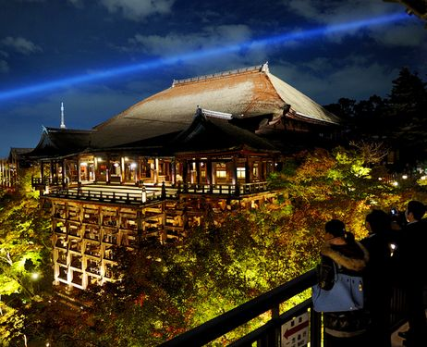
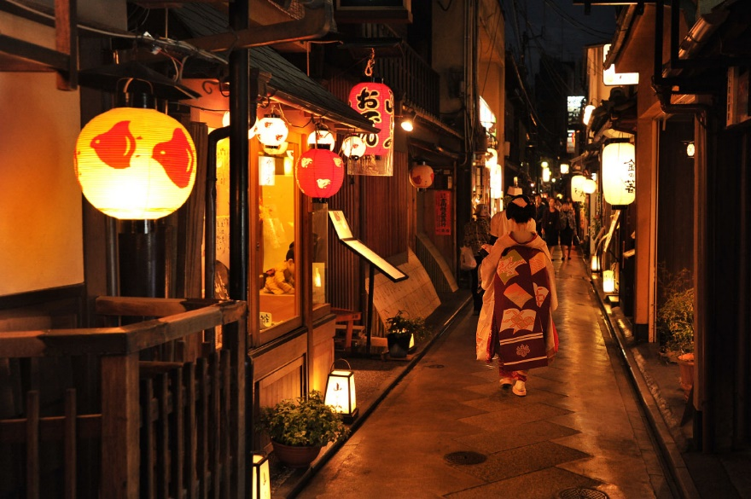
….than a thousand words

Slide 15
Use graphics….

Slide 16
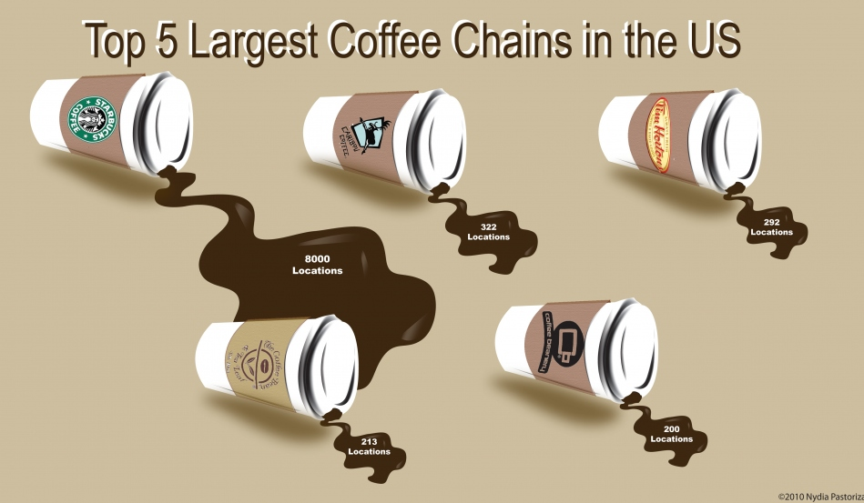
….or even better: info graphics!

Slide 17
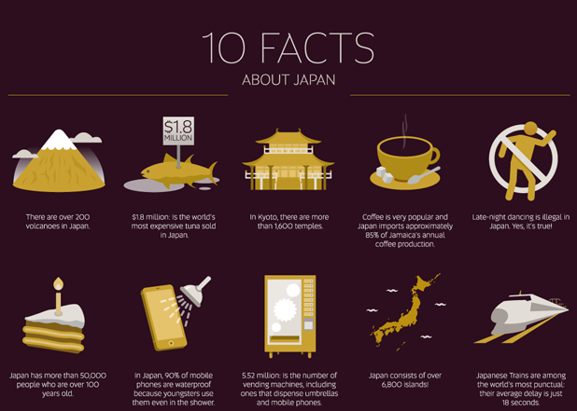
Vs
10 Facts About Japan
-More than 20 volcanos
-Kyoto has more than 1600 temples
-Late-night dancing is illegal
-Japan consists over 6800 islands

Slide 18
keep it short…..

Slide 19


Slide 20
Recommended resources
25 Great SlideShare/PowerPoint
http://blog.hubspot.com/marketing/inspiring-slideshare-presentations-for-marketers-list
5 great presentations: https://www.powtoon.com/presentation/5-best-presentations/
Presentation Zen: Simple Ideas on Presentation Design and Delivery (2nd Edition)
http://www.amazon.com/Presentation-Zen-Simple-Delivery-Edition/dp/0321811984

Slide 21
THANK you!

